Slide 1

ACES Consortium
Strategic Pathways

Slide 2

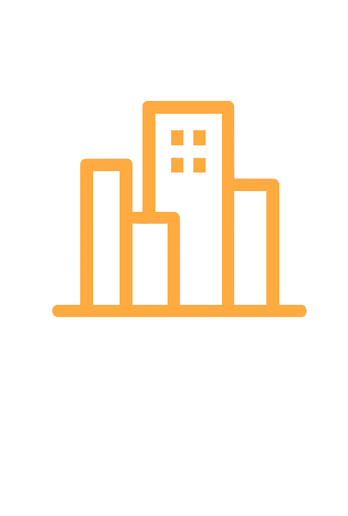
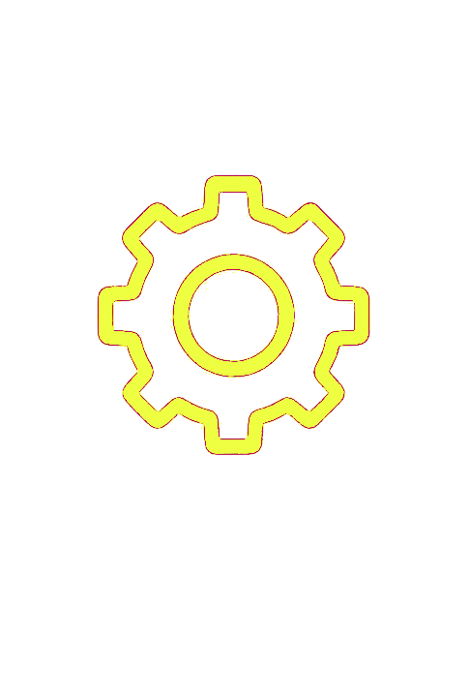
ACES Consortium - Why, How and What
Purpose
To drive standardization in IoT and robotics, creating the conditions for seamless integration, ecosystem growth, and greater value for producers, integrators, and users.
Key questions
Structure
Strategy
Value creation
Mission
Create a universal standard for physical interoperability of modular drones, robots, and IoT devices.
Target Applications
Agriculture
Smart Cities
Industry
ACES: Appliance Communications and Execution Standard
Notes:
The ACES Consortium exists to co-develop a common standard for the physical interoperability of modular drones, robots, and IoT devices. The protocol we are working on is called ACES—Appliance Communications and Execution Standard.
Our mission is to ensure that equipment from different manufacturers can be combined and deployed seamlessly in real-world environments. The initial focus is on agriculture, smart cities, and industry, but the ambition is broader: to establish a universal hardware language for modular systems.
With the technical work underway, we now face key questions that will shape the future of ACES. What structure should we adopt to manage it? What strategy will best position it for adoption? And how will value be created and shared among consortium partners?

Slide 3
Strategic Paths for ACES Development
Modular Dynamics Inc.
Proprietary consortium company
Owns and licenses ACES protocol
Revenue from module sales + services
Control and exclusivity
ACES Protocol Foundation
Non-profit association
ACES protocol open and royalty-free
Revenue indirect, via members’ products
Broad adoption and ecosystem growth
Shared mission: establish ACES as interoperability standard
Same target domains: agriculture, smart cities, industry
Development and Governance: led by consortium partners
Notes:
We have two possible strategic paths.
On one side is “Modular Dynamics,” a proprietary consortium company. This structure gives us direct control of ACES as intellectual property. It allows the consortium to generate revenue directly from module sales and professional services, while ensuring exclusivity and tight governance.
On the other side is the “ACES Foundation,” a non-profit structure. Here, the protocol itself is open and royalty-free, encouraging the broadest possible adoption. Members then capture value indirectly through sales of their own ACES-compliant products and services.
Despite these differences, both models share the same foundation: our joint mission to make ACES the standard for interoperability, focused on agriculture, smart cities, and industry. In both cases, this consortium remains the driving force behind development and governance.

Slide 4

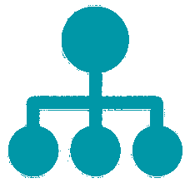




Option A – Modular Dynamics Inc.
Legal form
For-profit consortium company
GmbH, Ltd., Inc.
Governance
Shares held by members
Board decisions weighted by shares
Revenue streams
Hardware module sales
Professional services
Licensing fees
Strategic benefits
Tight control
Direct monetization
Exclusivity
IP
ACES protocol owned by company
Licensed under proprietary terms
Main risks
Slower adoption
vendor lock-in concerns
Higher capital needs for scaling
Notes:
In the Modular Dynamics model, we create a new for-profit consortium company—likely a GmbH or Ltd.—co-owned by our partners. Shares would be held in proportion to financial or in-kind contributions, and governance managed by a board representing those shareholders.
The company would own the ACES protocol outright. All intellectual property—specifications, connectors, software libraries—would be under proprietary control. Third parties wanting to use ACES would need a license from Modular Dynamics.
At first, we would not build factories. Instead, we would adapt off-the-shelf drones, robots, and IoT equipment into ACES-compliant modules. This keeps capital needs limited while generating revenue from integration and services. If adoption scales, we could then consider dedicated production facilities to improve efficiency and margins, though that would require larger investment.
Revenue streams would come from three areas: sales of ACES-compatible modules, professional services such as integration and maintenance, and licensing fees or royalties for third-party use.
The main advantage of this model is control. The consortium captures value directly, ensures quality through centralized ownership, and creates exclusivity for its members. The trade-offs are slower adoption, potential concerns about vendor lock-in, and eventually higher capital requirements if we expand into manufacturing.

Slide 5
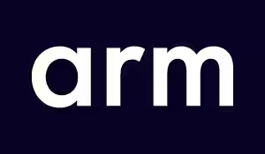


Proprietary European Precedents
ARM (UK)
Joint Venture Company: Acorn + Apple + VLSI
Licensed CPU IP, royalties on every chip
Became global standard (95%+ smartphones)
Lesson: proprietary JV can dominate if licensing is flexible and tech is strong
Symbian (EU)
Owned by Nokia, Ericsson, Motorola, Psion
Smartphone OS, >67% market share in 2006
Slow governance, overtaken by open rivals
Lesson: dominance can collapse without openness and speed
Z-Wave (Denmark)
Proprietary smart home protocol, one chip vendor
4,000+ certified products, but limited ecosystem
Specs opened in 2020 to sustain adoption
Lesson: proprietary IoT standards risk being sidelined, may need to open later losing the IP
Notes:
In this model, we would create a for-profit consortium company—Modular Dynamics—that owns ACES as intellectual property. The company would be co-owned by consortium members, with governance tied to shareholding.
Revenues would come from selling ACES-compatible hardware modules, providing services such as integration and maintenance, and licensing the protocol to third parties. The main benefit is tight control: the consortium captures value directly and ensures exclusivity for its members.
But there are risks. Because ACES would be proprietary, adoption outside the consortium could be slower. Potential customers and partners may worry about vendor lock-in. And the pace of innovation would depend heavily on us alone, without the contributions that an open community might bring.

Slide 6
Option B – ACES Foundation
Legal form
Non-profit association
AISBL, e.V.
Governance
Member-based
One-member-one-vote
Committee-driven
Revenue streams
Consulting
Certification
ACES-compatible products and services
Strategic benefits
Broad adoption
Credibility (public sector)
Ecosystem growth
Faster innovation
IP
ACES protocol Open Source
Permissive license
IP owned by foundation
Main risks
No direct IP revenue
Competitors can leverage ACES
Slower decision-making
Notes:
In the Modular Dynamics model, we create a new for-profit consortium company—likely a GmbH or Ltd.—co-owned by our partners. Shares would be held in proportion to financial or in-kind contributions, and governance managed by a board representing those shareholders.
The company would own the ACES protocol outright. All intellectual property—specifications, connectors, software libraries—would be under proprietary control. Third parties wanting to use ACES would need a license from Modular Dynamics.
At first, we would not build factories. Instead, we would adapt off-the-shelf drones, robots, and IoT equipment into ACES-compliant modules. This keeps capital needs limited while generating revenue from integration and services. If adoption scales, we could then consider dedicated production facilities to improve efficiency and margins, though that would require larger investment.
Revenue streams would come from three areas: sales of ACES-compatible modules, professional services such as integration and maintenance, and licensing fees or royalties for third-party use.
The main advantage of this model is control. The consortium captures value directly, ensures quality through centralized ownership, and creates exclusivity for its members. The trade-offs are slower adoption, potential concerns about vendor lock-in, and eventually higher capital requirements if we expand into manufacturing.

Slide 7

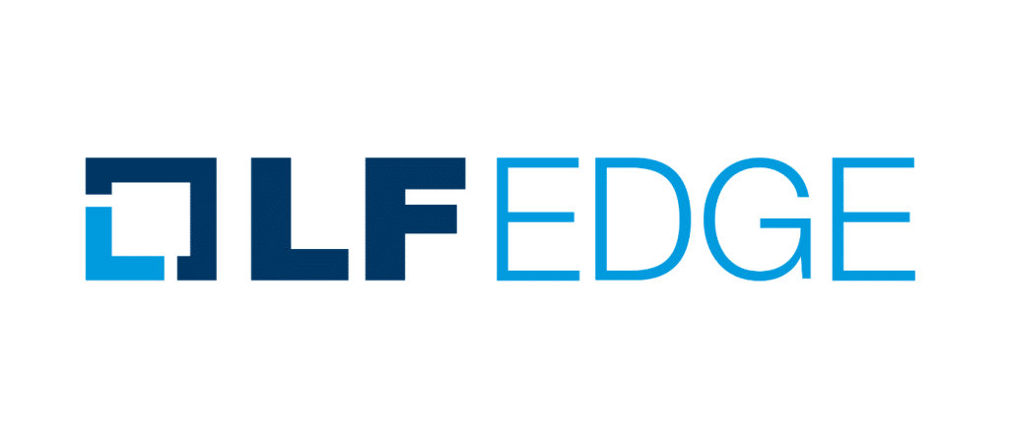
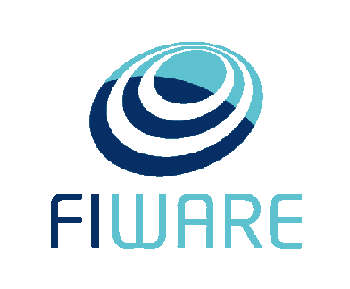
Open European Precedents
KNX Association
(Belgium)
Full Success
Founded in 1999 as non-profit cooperative (cvba)
Published royalty-free building automation standard (EN 50090, ISO/IEC 14543)
500+ manufacturer members, 100,000+ certified installers in 172 countries
Lesson: open governance sustained global adoption and long-term ecosystem
LF Edge
(Global, EU Members)
Partial Success
Open foundation for edge computing (part of Linux Foundation)
Backed by major vendors
Faced issues with governance complexity, uneven contributions, reliance on few core actors
Lesson: open foundations can stall if funding and community engagement are fragile
FIWARE Foundation (Germany)
Gaining Traction
Established 2016 as non-profit e.V.
Provides open APIs (NGSI-LD) and Smart Data Models for IoT
Adopted by 350+ cities, growing developer ecosystem
Lesson: open software standard is expanding across smart cities and agriculture
Notes:
Let’s look at three examples of open foundation models from Europe.
KNX Association is a textbook success story. Formed in Belgium in 1999, it brought together competing proprietary building automation systems under one roof. As a non-profit cooperative, KNX made its standard royalty-free, vendor-neutral, and submitted it to European and international standards bodies. The result has been extraordinary: today, more than 500 manufacturers build KNX-compatible products, and there are over 100,000 certified installers in 172 countries. KNX shows how an open governance model can sustain global adoption for decades and create a self-reinforcing ecosystem.
LF Edge, on the other hand, illustrates some of the challenges. Launched in 2019 under the Linux Foundation, it set out to unify fragmented open-source edge computing projects. On paper, it had impressive backing—Intel, Samsung, Ericsson, Nokia, Arm, and many others. In practice, governance became complicated, with many big vendors pulling in different directions. Contributions were heavily concentrated in just a few companies, while most members offered their names but little code. Adoption was uneven too: one project, EdgeX Foundry, saw some uptake, but others lagged. The overall initiative never became the de facto standard for edge computing; cloud hyperscalers and proprietary frameworks kept the upper hand. LF Edge shows that even an open foundation with strong corporate support can struggle if governance is complex, contributions are shallow, and adoption lags behind closed competitors.
Finally, FIWARE Foundation represents a case that is gaining strong traction. Established in Germany in 2016, FIWARE provides open APIs and Smart Data Models for IoT and smart cities, with its NGSI-LD API becoming an ETSI standard. Adoption has grown steadily, and today more than 350 cities around the world use FIWARE. The foundation has cultivated a large developer community and secured EU support, helping it expand into domains like agriculture and industry. FIWARE demonstrates how an open software foundation, with strong community backing and public-sector alignment, can achieve rapid adoption and become a credible standard across multiple sectors.
Together, these examples show the spectrum of outcomes possible under the open foundation model—from sustained global dominance, to partial impact with challenges, to active growth in progress.

Slide 8
FIWARE and LF Edge - Synergy with ACES
Illustrative Flow:
Application issues a command (FIWARE) → LF Edge runtime translates and routes it →
ACES module executes → telemetry returns → LF Edge normalizes → FIWARE updates context model
FIWARE – Data & Applications
Offers standardized APIs (NGSI-LD) and Smart Data Models for context management.
Provides a unified language for applications, analytics, and integration with cities, farms, and industries
Together, these frameworks form a complete stack for IoT and robotics interoperability:
ACES (Do)
LF Edge (Run)
FIWARE (Know).
LF Edge – Edge Runtime & Orchestration
Provides common services to manage heterogeneous devices at the edge.
Buffers, secures, and translates ACES messages into software-ready form.
ACES – Hardware Interoperability
Standardized connectors and communications for drones, robots, sensors, and other IoT modules.
Ensures plug-and-play compatibility across multiple manufacturers.
Notes:
Speaker Notes:
FIWARE already provides the open standard for software interoperability. It manages how data flows between devices and applications, with NGSI-LD as an ETSI-recognized API. This is deployed in hundreds of cities and spreading into agriculture and industry.
ACES is complementary, because it would cover the hardware interoperability layer. That means plug-and-play modules—drones, robots, sensors—that can physically work together, regardless of manufacturer.
The question is how we leverage FIWARE under the two models we are considering.
If we take the proprietary route and create Modular Dynamics, we can still adopt FIWARE’s open-source components as the software layer, because FIWARE is free to use. We could also join the FIWARE Foundation as a company, gaining influence and visibility, while keeping ACES itself proprietary.
If we take the open route and establish the ACES Foundation, then we could go further. We could form a formal partnership between ACES Foundation and FIWARE Foundation, aligning hardware and software standards under a common open governance framework. That would create a stronger ecosystem and could attract more public-sector support.
So in both cases, FIWARE is a tool we can build on. The difference is whether we use it tactically, as part of a proprietary stack, or strategically, as part of a larger open-standard alliance.

Slide 9
Model Comparison
Aspect | Modular Dynamics (Proprietary) | ACES Foundation (Open)
Ownership | Company owns ACES IP, licenses it | Foundation holds IP, royalty-free
Governance | Board weighted by shareholding | Member-based, consensus-driven
Monetization | Direct: modules, services, licenses | Indirect: partners sell ACES products/services
Adoption | Slower, limited to licensees | Faster, broad ecosystem
Investment | Higher (factories if scaling) | Lower, focus on product innovation
FIWARE | Use freely, optional membership | Formal partnership possible
LF Edge | Runtime embedded in proprietary stack to manage ACES modules | Runtime used as open bridge between modules & apps
Notes:
We have reached a fork in the road. The proprietary route gives us direct control and revenue, but comes with higher investment and slower adoption. The open route trades exclusivity for scale, positioning ACES as a universal standard while members capture value through their own products and services. In both cases, FIWARE can be leveraged—the difference is whether we use it tactically or partner strategically.

Slide 10
Partner benefits
Partner | Modular Dynamics (Proprietary) | ACES Foundation (Open)
Agrobots | Access to proprietary modules, lock-in advantage with farms. | Easier procurement and adoption.
Dronak | Direct revenue share, exclusive modules, tighter integration. | Wider adoption of drones through open interoperability; stronger appeal to cities/farms.
Smart City Charge | Access to proprietary modules, lock-in advantage with municipalities. | Easier procurement and adoption (public sector prefers open standards); more projects.
Sintropia | Preferred integrator status, limited competition, tied to JV success. | Larger addressable market; more integration projects across industries.
Smart Farm Robotix | Bundling advantage: robots + ACES modules as closed solution. | Broader interoperability with other equipment; bigger market for ACES-compliant robots.
Notes:
Here is what each option means in practical terms for us as consortium members.
For the drone maker, Modular Dynamics offers direct revenue and exclusive integration opportunities, but the open foundation expands the market for drones by making them interoperable in many more deployments.
For the smart city developer, the proprietary route means having exclusive access to modules and the ability to lock in city contracts. But in reality, municipalities often prefer open standards, so the foundation model may make adoption smoother and projects easier to win.
For the IoT integrator, the proprietary model would grant preferred status and higher margins, but it limits the market to ACES licensees. The open model creates a much larger market of adopters, meaning more projects to integrate.
For the farm robot builder, Modular Dynamics offers bundling advantages—robots packaged with ACES modules as a closed system. But the foundation route allows broader interoperability with tractors, sensors, and equipment from others, expanding the total market for ACES-compliant robots.
So the impact is clear: the proprietary model concentrates control and revenue, while the open model expands the ecosystem and project opportunities.

Slide 11
Next Steps for the Consortium
Confirm shared mission:
Create a universal standard for physical interoperability of modular drones, robots, and IoT devices.
Decide on organizational model:
  Modular Dynamics (proprietary)
  ACES Foundation (open)
Define role of FIWARE and LF Edge in our strategy
Outline governance, investment, and value-sharing principles
Prepare roadmap and MoU for consortium partners
Notes:
We have a clear mission: to make ACES the interoperability standard for modular drones, robots, and IoT devices.
The next step is to align on which organizational model we will pursue. Modular Dynamics gives us direct control and monetization, while the ACES Foundation gives us scale and broad adoption. Both are viable, but the choice will shape our structure, our strategy, and our investment path.
In either model, FIWARE can play a valuable role in the software layer. We should decide whether we simply adopt it as a component or pursue a formal partnership.
Once we have chosen the model, we can define governance, investment levels, and value-sharing principles for partners, and then move toward a joint roadmap and a memorandum of understanding.
This will give us the clarity and structure needed to present ACES to external stakeholders and move the project forward with confidence.

